Slide 1
Model Selection & Tuning

Slide 2
Qualities of a good model
High accuracy scores in unseen data (test / production)\
Generalizable i.e. perform consistently on the test / production data
Easy on computation resources both during training and in production
Scalable in production
Easy to implement in production
Easy to explain

Slide 3
Accuracy & Generalizability

Slide 4
Highly Accurate & Generalizable Model
Models generalize well when they are neither overfit nor underfit
Right fit models are the ones which have minimal bias and variance errors
How does one know whether the current version of a model has the minimal bias variance error?
Measure the accuracy of the model both for training and testing data simultaneously
Depending on a single test set is not reliable method to judge the quality of a model
Since we do not have multiple test sets, we use K-fold cross validation and / or Boot Strap sampling to mimic multiple test sets

Slide 5
Modelling Errors
All models are impacted by three types of errors which reduce their predicting power.
Bias error
Variance errors
Random errors
Bias errors
Caused by the decisions taken at the various stages of modelling starting from data collection / sampling stage
Choice of attributes based on the analysis of the data available
Choice of the complexity of the model based on observations in the data
Splitting the data into training validation and testing
Class size. Algorithms have a bias towards higher represented class for overall accuracy
Variance errors (Known variance)
Variance in the behaviour of the model
The model based on a sample will perform differently on different samples
Variance errors increase with increase in number of attributes in the model due to increase in degrees of freedom for the data points to wriggle in
Random errors (unknown variance)
Caused by unknown factors. They cannot be modelled

Slide 6

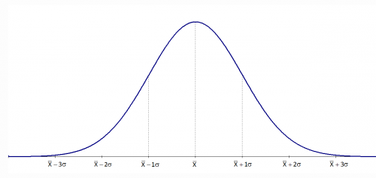
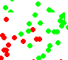

Modelling Errors – Variance error
Universe / Population
Time T1
Time T2
Sample / snapshot

Slide 7
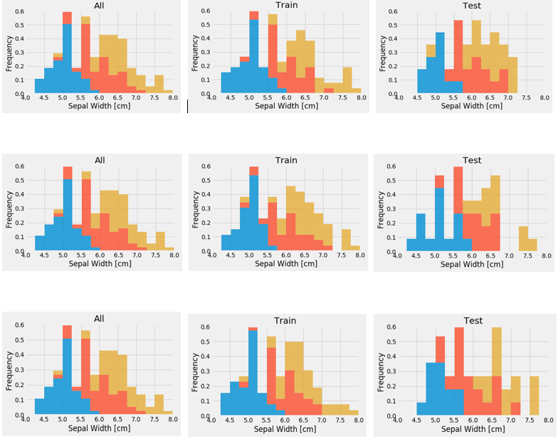
Modelling Errors Visaual demo of variance in training and test data
Sample Data (Analytics Base Table)
Three Random Training Sets From ABT
Three Random Test Sets From ABT

Slide 8
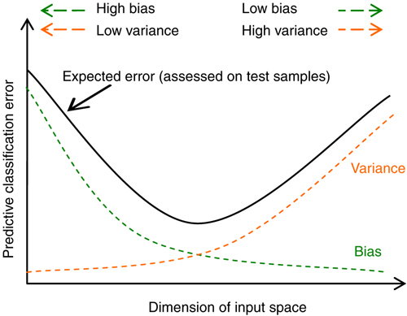
Modelling Errors
We have to find the right attributes and the right number of dimensions such that the total effect of these two (indicated by black curve) minimizes.
The gap between variance curve and total error curve reflects presence of random errors in the model

Slide 9
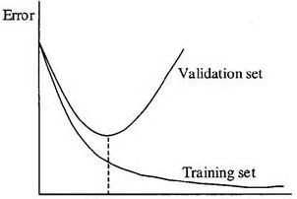
Modelling Errors
As we move from left to right, we move away from underfit to overfit model
In the underfit case, both the training and validation errors are high
In overfit case, the training set error continues to minimize i.e. training accuracy goes very high (not shown), while the validation error increases i.e validation accuracy drops much below training accuracy

Slide 10
Fitness of a Model
Generalize
Models are expected to perform well (meet least accuracy thresholds) in production (real world data)
But data in real world is under flux / jiggle
Models have to perform in this context of continuous jiggle. Such models are said to generalize well
For models to generalize well, they should neither be underfit or overfit in the training data
Underfit models
Models that are over simplified i.e. models in which the independent and dependent attributes interact in a simple linear way ( can be expressed in a linear form for e.g. y = mx + c).
The model could have been addressed as a quadratic form such as y = m1x + m2 x^2 +C
Underfit models result in errors as they fail to capture the complex interactions among the attributes in the real world
These models will not generalize in the real world
Overfit models
Models that perform very well (sometimes with zero errors) in training data
Are complex polynomial surfaces that twist and turn in the feature space to cleanly separate the classes
Adjust to the variance in the training data i.e. try to adjust to the positions of the data points though those positions are not the expected values of the data points (mean of the jiggle)
These models adapt to the variance error in the data set and will not generalize in the real world

Slide 11
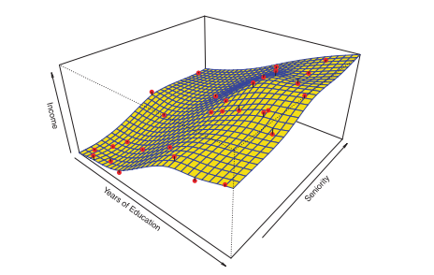
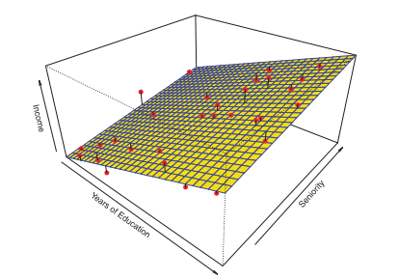
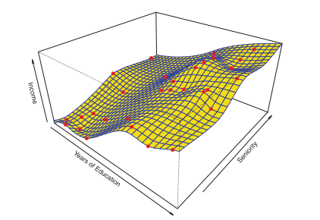
Fitness of a Model
Good fit
Over fit
Underfit
In overfit models, the models absorb the noise (variance) in the data points achieving almost 100% accuracy in controlled environment. But when used in production (where the data points have different variance, the models will perform poorly

Slide 12
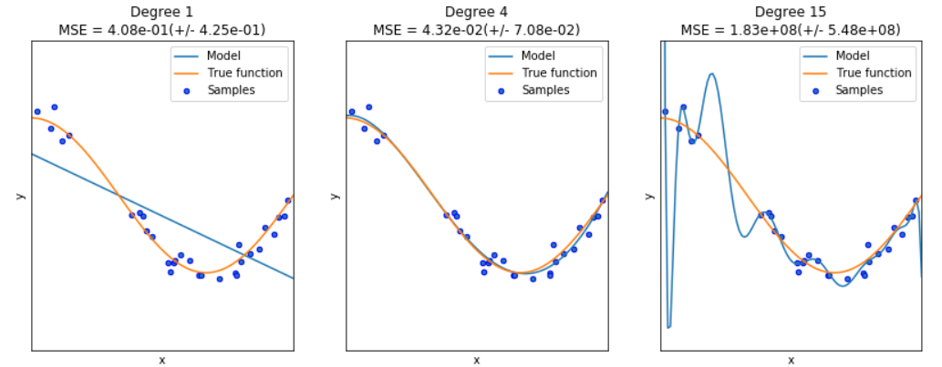
Fitness of a Model
Under Fit
Good Fit
Over Fit
When the interaction between the attributes and target dimensions are oversimplified. Fail to generalize
Right fit. Will generalize relatively much better
When the interaction between the attributes and target dimensions are overly complex in the model. Fail to generalize

Slide 13
Cross Validation

Slide 14
Need for cross validation?
We wish to know how well a ML model is likely to perform in production.
Model’s performance in training is no guarantee production performance
To estimate the model production score, hold a part of the sample data out of training phase. We call it test data which represents the universe
Usually the available data is not sufficient to split into training and test set and expect the two to represent the universe
Hence the model error on test data may not be good estimate of the model error in the universe
In the absence of large data sets, a number of techniques can be employed to estimate the model error in production
One of the techniques is cross validation

Slide 15
Car_MPG prediction accuracy trained on 70% and tested on 30%
For each run, we get different accuracy scores
Simple training/test a.k.a validation approach gives varying results with every run (random state not set)
Thus we cannot rely on one round of testing as we would have by chance got the split that gives max score first time
To get a more realistic estimate, we have to use more reliable techniques such as cross validation

Slide 16
What is cross validation?
Cross-validation is a technique to evaluate / validate a machine learning model and estimate its performance on unseen data
The techniques creates and validates given model multiple times
The number of times it does so, is dependent on the value selected by the user of the technique. Usually expressed as “K” which is always an integer
The sequence of steps used is iterated through as many times as K
The process begins by dividing the original data into K parts / folds using random function

Slide 17
Cross validation procedure
Shuffle the dataset randomly
Split the dataset into k folds
For each distinct fold:
Keep the fold data separate / hold out data set
Use the remaining folds as a single training data set
Fit the model on the training set and evaluate it on the test set
Retain the evaluation score and discard the model
Loop back
The steps 3.a to 3.e will be executed K times
Summarize the scores and average it by dividing the sum by K.
Analyze the average score, the dispersion to assess the likely performance of the model in the unseen data (production data / universe)

Slide 18
Implementing K Fold cross validation
Visual understanding (example based on scikitlearn guide)
from numpy import array
from sklearn.model_selection import KFold
data = array([10,20,30,40,50,60,70,80,90,100])
kfold = KFold(5, True)
for train, test in kfold.split(data):
print('train: %s, test: %s' % (data[train], data[test]))
Training Data [ 10 20 30 40 50 60 80 90] | Test Data [70 100]
[ 10 40 50 60 70 80 90 100] | [20 30]
[ 10 20 30 40 50 70 90 100] | [60 80]
[ 10 20 30 50 60 70 80 100] | [40 90]
[ 20 30 40 60 70 80 90 100] | [10 50]
Note : We cannot have K > number of data points…. Why?

Slide 19
Configuring the K
K is an integral number. Minimum value of K has to be 2. There will be two iterations in this case
Max value of K can be the number of data points. This is also known as Leave One Out Cross Validation or LOOCV
Whatever the value of K chosen, the resulting training and test data should be representative of the unseen data as much as possible
There is not formula to decide the K but K = 10 is usually considered good
Too large a K, means less variance across the training sets thus limit the model differences across iterations
For a sample size (N) of n, and K = k, number of records (r) per fold = n/k.

Slide 20
Evaluating the model in an iteration
In each iteration, the model is trained on K -1 number of folds and evaluated on the left out fold.
The MSE or Mean Squared Error is thus calculated on the left out fold
Since the procedure is repeated K times, we will have K MSEs. Total up all the MSE and divide by K to get the overall expected MSE
CVk = 1/k(sum(MSEi) for I = 1 to K

Slide 21
Some salient features of K-fold
Each record / data point in the sample data before creating the Kfolds, is assigned to a single fold and stays in that fold for the duration of the procedure.
This means that each data point is used once in hold-out set and K-1 times in training
Very important point to keep in mind is, any transformation to data such as standardizing or any other data preparation that is required before building the model, must be done in the iteration on the training folds rather than on the entire data set.
When hyper parameters are to be tweaked, split the original data into two. Keep one part aside. Use the other to do the Kfold validation. Once the optimal hyperparameters are found, assess the model on the test data
Any data transformation done on the whole set outside the loop, may lead to data leakage and overfitting

Slide 22
Implementing K Fold cross validation
K fold in Pima Indian Classification
from pandas import read_csv
from sklearn.model_selection import train_test_split
from sklearn.linear_model import LogisticRegression
from sklearn.model_selection import KFold
from sklearn.model_selection import cross_val_score
import numpy as np
filename = 'pima-indians-diabetes.data'
names = ['preg', 'plas', 'pres', 'skin', 'test', 'mass', 'pedi', 'age', 'class']
dataframe = read_csv(filename, names=names)
array = dataframe.values
X = array[:,0:8]
Y = array[:,8]
num_folds = 50
seed = 7
kfold = KFold(n_splits=num_folds, random_state=seed)
model = LogisticRegression()
results = cross_val_score(model, X, Y, cv=kfold)
print(results)
print("Accuracy: %.3f%% (%.3f%%)" % (results.mean()*100.0, results.std()*100.0))

Slide 23
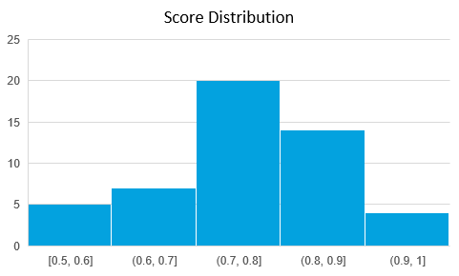
Mean | 0.770166667
Standard Error | 0.015172553
Median | 0.8
Mode | 0.8
Standard Deviation | 0.107286148
Sample Variance | 0.011510317
Kurtosis | 0.2246995
Skewness | -0.267638887
Range | 0.5
Minimum | 0.5
Maximum | 1
Sum | 38.50833335
Count | 50
Confidence Level(95.0%) | 0.030490386
Distribution of the scores on 50 iterations
Model accuracy is likely to be in 0.77 – 0.03 to 0.77 + 0.03 i.e. 0.74 – 0.80 at 95% confidence level

Slide 24
Leave One Out Cross validation (LOOCV) procedure
In this method, a single observation (x1, y1) is used for the validation set and the remaining (x2,y2)…. (xn, yn) make up the training set
The statistical model is fit on the n-1 training examples
The statistical model prediction yhat is made for the excluded observation using x1.
MSE1 = (yhat – y)^2 for the excluded point
The MSE is unbiased but is poor estimate because it is highly variable
We can repeat this by keeping every data point for test one at a time and using rest for training

Slide 25
Leave One Out Cross validation (LOOCV) procedure
Repeating this approach n times we get MSE1, MSE2,…. MSEn
CV(n) = sum(MSEi) for i=1 to n / n
LOOCV is a special case of Kfold validation with K = n
# scikit-learn k-fold cross-validation
from numpy import array
from sklearn.model_selection import LeaveOneOut
# data sample
data = array([10,20,30,40,50,60,70,80,90,100])
# prepare cross validation
loocv = LeaveOneOut()
# enumerate splits
for train, test in loocv.split(data):
print('train: %s, test: %s' % (data[train], data[test]))
train: [ 20 30 40 50 60 70 80 90 100], test: [10]
train: [ 10 30 40 50 60 70 80 90 100], test: [20]
train: [ 10 20 40 50 60 70 80 90 100], test: [30]
train: [ 10 20 30 50 60 70 80 90 100], test: [40]
train: [ 10 20 30 40 60 70 80 90 100], test: [50]
train: [ 10 20 30 40 50 70 80 90 100], test: [60]
train: [ 10 20 30 40 50 60 80 90 100], test: [70]
train: [ 10 20 30 40 50 60 70 90 100], test: [80]
train: [ 10 20 30 40 50 60 70 80 100], test: [90]
train: [10 20 30 40 50 60 70 80 90], test: [100]

Slide 26
Leave One Out Cross validation (LOOCV) procedure
from pandas import read_csv
from sklearn.model_selection import train_test_split
from sklearn.linear_model import LogisticRegression
from sklearn.model_selection import LeaveOneOut
from sklearn.model_selection import cross_val_score
import numpy as np
# prepare cross validation
loocv = LeaveOneOut()
model = LogisticRegression()
filename = 'pima-indians-diabetes.data'
names = ['preg', 'plas', 'pres', 'skin', 'test', 'mass', 'pedi', 'age', 'class']
dataframe = read_csv(filename, names=names)
array = dataframe.values
X = array[:,0:8]
Y = array[:,8]
results = cross_val_score(model, X, Y, cv=loocv)
print("Accuracy: %.3f%% (%.3f%%)" % (results.mean()*100.0, results.std()*100.0))
Accuracy: 76.953% (42.113%) (Compare the standard deviation with KFOLD which is much less)

Slide 27
Bias Variance tradeoff and cross validation
LOOCV, which gets 90% of the data and multiple iterations, is likely to commit less bias errors. However, since only 10% of the data is left for testing, the variance errors will be high
K-Fold cross validation, which lies between simple validation and LOOCV approach, can give more moderate error rates.
By selecting right K, we can minimize both the bias and variance errors. The overall error rate is likely to be the model performance in the production

Slide 28
BootStrap Sampling
Also known as sampling with replacement, is a sampling technique used when the amount of data is limited
A random function is used to create the sample from the original dataset. That a record has already been picked earlier for the sample is immaterial.
Within a sample, there may be repeating records. Could be duplicates or more but two sample sets are unlikely to be 100% same.
The records not picked up in an iteration will serve the purpose of test data and test data will always have unique records
Suppose we have 10 data points in the dataset. We can create multiple sample sets each with 10 data points or less and corresponding test data.
The number of samples created maybe 10, more than 10 or less than 10
The more the samples we create from a small size data, more likely we will have samples that are very similar in terms of the data points

Slide 29
BootStrap Sampling
from sklearn.utils import resample
import numpy as np
# load dataset
data = [10,20,30,40,50,60,70,80,90,100] # original data with 10 data points
# configure bootstrap
n_iterations = 50 # Number of bootstrap samples to create = 50
n_size = int(len(data) * 1) # picking only 50 % of the given data in every bootstrap sample
# run bootstrap
stats = list()
for i in range(n_iterations):
# prepare train and test sets
train = resample(data, n_samples=n_size) # Sampling with replacement
test = np.array([x for x in data if x not in train]) # picking rest of the data not considered in sample
print("Train_data ->", train, " " , "Test_data ->", test)

Slide 30
Boot Strap sample -
Train_data -> [30, 30, 30, 90, 20, 80, 30, 80, 40, 10] Test_data -> [ 50 60 70 100]
Train_data -> [50, 80, 20, 20, 40, 40, 50, 100, 70, 70] Test_data -> [10 30 60 90]
Train_data -> [10, 80, 40, 80, 90, 100, 30, 80, 90, 20] Test_data -> [50 60 70]
Train_data -> [30, 30, 40, 70, 70, 50, 100, 100, 70, 20] Test_data -> [10 60 80 90]
Train_data -> [90, 30, 100, 40, 10, 30, 30, 50, 10, 30] Test_data -> [20 60 70 80]
Train_data -> [30, 40, 30, 20, 80, 20, 10, 30, 50, 40] Test_data -> [ 60 70 90 100]
Train_data -> [70, 30, 60, 30, 80, 100, 40, 20, 70, 70] Test_data -> [10 50 90]
Train_data -> [100, 30, 70, 100, 90, 90, 10, 60, 60, 70] Test_data -> [20 40 50 80]
Train_data -> [40, 40, 30, 90, 90, 30, 90, 10, 60, 100] Test_data -> [20 50 70 80]
Train_data -> [10, 90, 70, 70, 30, 20, 70, 70, 90, 40] Test_data -> [ 50 60 80 100]
Train_data -> [100, 40, 100, 90, 100, 50, 30, 50, 20, 40] Test_data -> [10 60 70 80]
Train_data -> [50, 20, 10, 50, 50, 20, 60, 20, 40, 100] Test_data -> [30 70 80 90]
Train_data -> [10, 20, 10, 40, 60, 30, 20, 30, 80, 80] Test_data -> [ 50 70 90 100]
Train_data -> [50, 90, 50, 60, 50, 90, 40, 30, 40, 50] Test_data -> [ 10 20 70 80 100]
Train_data -> [100, 70, 100, 70, 100, 70, 90, 20, 20, 60] Test_data -> [10 30 40 50 80]
Train_data -> [80, 30, 100, 60, 40, 20, 100, 70, 20, 60] Test_data -> [10 50 90]
Train_data -> [20, 100, 50, 70, 50, 10, 50, 60, 30, 70] Test_data -> [40 80 90]
Train_data -> [10, 60, 90, 40, 50, 100, 50, 50, 20, 80] Test_data -> [30 70]
Train_data -> [20, 30, 80, 10, 100, 80, 60, 90, 50, 80] Test_data -> [40 70]
Train_data -> [10, 20, 70, 10, 80, 60, 50, 20, 20, 10] Test_data -> [ 30 40 90 100]
Train_data -> [90, 70, 50, 100, 20, 60, 60, 90, 60, 70] Test_data -> [10 30 40 80]
Train_data -> [80, 20, 100, 10, 80, 30, 100, 20, 60, 100] Test_data -> [40 50 70 90]
Train_data -> [10, 90, 20, 90, 50, 80, 30, 100, 10, 80] Test_data -> [40 60 70]
Train_data -> [100, 30, 30, 70, 90, 30, 30, 90, 100, 10] Test_data -> [20 40 50 60 80]
Train_data -> [20, 10, 40, 20, 20, 40, 20, 90, 100, 50] Test_data -> [30 60 70 80]
Train_data -> [20, 100, 50, 60, 80, 70, 90, 20, 90, 40] Test_data -> [10 30]
Train_data -> [70, 20, 100, 20, 40, 60, 30, 80, 80, 70] Test_data -> [10 50 90]

Slide 31
Boot Strap sample (contd…) -
Train_data -> [70, 50, 80, 60, 100, 60, 40, 80, 70, 100] Test_data -> [10 20 30 90]
Train_data -> [40, 90, 80, 20, 10, 70, 10, 80, 90, 60] Test_data -> [ 30 50 100]
Train_data -> [50, 80, 90, 90, 80, 80, 80, 20, 30, 90] Test_data -> [ 10 40 60 70 100]
Train_data -> [90, 40, 40, 80, 20, 80, 90, 30, 50, 90] Test_data -> [ 10 60 70 100]
Train_data -> [40, 50, 100, 100, 70, 60, 40, 100, 50, 10] Test_data -> [20 30 80 90]
Train_data -> [30, 20, 30, 70, 20, 20, 30, 80, 40, 70] Test_data -> [ 10 50 60 90 100]
Train_data -> [10, 10, 70, 50, 60, 40, 70, 70, 100, 10] Test_data -> [20 30 80 90]
Train_data -> [10, 40, 50, 100, 30, 100, 20, 10, 80, 70] Test_data -> [60 90]
Train_data -> [90, 30, 10, 70, 50, 40, 30, 100, 20, 40] Test_data -> [60 80]
Train_data -> [40, 50, 90, 100, 30, 100, 90, 30, 50, 70] Test_data -> [10 20 60 80]
Train_data -> [30, 10, 20, 70, 60, 90, 90, 30, 70, 60] Test_data -> [ 40 50 80 100]
Train_data -> [100, 60, 90, 20, 100, 70, 20, 50, 70, 100] Test_data -> [10 30 40 80]
Train_data -> [50, 90, 30, 60, 40, 80, 20, 10, 40, 90] Test_data -> [ 70 100]
Train_data -> [10, 30, 20, 10, 80, 60, 20, 40, 20, 70] Test_data -> [ 50 90 100]
Train_data -> [90, 100, 60, 80, 10, 90, 20, 30, 30, 30] Test_data -> [40 50 70]
Train_data -> [60, 70, 70, 100, 20, 30, 20, 50, 60, 70] Test_data -> [10 40 80 90]
Train_data -> [20, 10, 50, 30, 90, 50, 100, 80, 40, 100] Test_data -> [60 70]
Train_data -> [10, 30, 10, 40, 80, 60, 20, 40, 60, 30] Test_data -> [ 50 70 90 100]
Train_data -> [60, 100, 70, 70, 70, 20, 30, 90, 90, 20] Test_data -> [10 40 50 80]
Train_data -> [40, 80, 80, 20, 80, 90, 50, 30, 30, 80] Test_data -> [ 10 60 70 100]
Train_data -> [10, 50, 60, 70, 100, 60, 30, 80, 100, 70] Test_data -> [20 40 90]
Train_data -> [80, 20, 40, 100, 10, 90, 50, 40, 90, 20] Test_data -> [30 60 70]
Train_data -> [10, 70, 60, 50, 50, 100, 40, 50, 80, 50] Test_data -> [20 30 90]

Slide 32
BootStrap Sampling
With the bootstrap samples available, we can create models on the training and test and average out the scores over all the runs. Refer to the attachment
When we create and test our model on bootstrapped data set, each iteration will give a performance score
When we increase the number of iterations to a large number and plot the frequency curve for the performance scores, one will notice the performance scores tend to follow normal distribution.
For very large number of iterations, the distribution becomes almost normal. This is known as the Central Limit Theorem.
Central Limit Theorem states “the sampling distribution of the sample means approaches a normal distribution as the sample size gets larger — no matter what the shape of the population distribution.

Slide 33
BootStrap Sampling
With the bootstrap samples available, we can create models on the training and test and average out the scores over all the runs. Refer to the attachment
When we create and test our model on bootstrapped data set, each iteration will give a performance score
When we increase the number of iterations to a large number and plot the frequency curve for the performance scores, one will notice the performance scores tend to follow normal distribution.
For very large number of iterations, the distribution becomes almost normal. This is known as the Central Limit Theorem.
Central Limit Theorem states “the sampling distribution of the sample means approaches a normal distribution as the sample size gets larger — no matter what the shape of the population distribution.

Slide 34
from pandas import read_csv
from sklearn.utils import resample
from sklearn.tree import DecisionTreeClassifier
from sklearn.metrics import accuracy_score
from matplotlib import pyplot
import numpy as np
# load dataset
data = read_csv('pima-indians-diabetes.data', header=None)
values = data.values
# configure bootstrap
n_iterations = 1000 # Number of bootstrap samples to create
n_size = int(len(data) * 0.50) # picking only 50 % of the given data in every bootstrap sample
# run bootstrap
stats = list()
for i in range(n_iterations):
# prepare train and test sets
train = resample(values, n_samples=n_size) # Sampling with replacement
test = np.array([x for x in values if x.tolist() not in train.tolist()]) # picking rest of the data not considered in sample
# fit model
model = DecisionTreeClassifier()
model.fit(train[:,:-1], train[:,-1])
# evaluate model
predictions = model.predict(test[:,:-1])
score = accuracy_score(test[:,-1], predictions) # caution, overall accuracy score can mislead when classes are imbalanced
print(score)
stats.append(score)

Slide 35
Model performance measures
We never give point estimates for model’s performance in production. We always give range estimates. For e.g. model accuracy is likely to be in the range of 80% - 95%
Range estimates indicate lack of surety. Which means less than 100% sure. Hence, range estimates need to be backed up by confidence level. How confident are we in the range.
Larger the range more confident we are. But range cannot be too large. The model becomes unreliable!
The general practice is to quote the range at 95% confidence level. If you are working in life critical projects, one needs to be 99.99999% confident
The range can be estimated through K-Fold validation or Bootstrap sampling

Slide 36
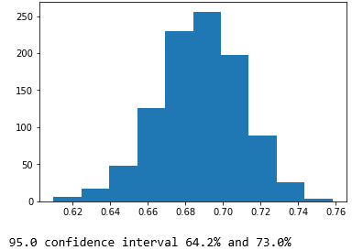
Model Accuracy estimates using BootStrapping
# plot scores
pyplot.hist(stats)
pyplot.show()
# confidence intervals
alpha = 0.95 # for 95% confidence
p = ((1.0-alpha)/2.0) * 100 # tail regions on right and left .25 on each side indicated by P value (border)
lower = max(0.0, np.percentile(stats, p))
p = (alpha+((1.0-alpha)/2.0)) * 100
upper = min(1.0, np.percentile(stats, p))
print('%.1f confidence interval %.1f%% and %.1f%%' % (alpha*100, lower*100, upper*100))

Slide 37
Model Accuracy estimates using Kfold Validation
Mean | 0.770166667
Standard Error | 0.015172553
Median | 0.8
Mode | 0.8
Standard Deviation | 0.107286148
Sample Variance | 0.011510317
Kurtosis | 0.2246995
Skewness | -0.267638887
Range | 0.5
Minimum | 0.5
Maximum | 1
Sum | 38.50833335
Count | 50
Confidence Level(95.0%) | 0.030490386
Model accuracy is likely to be in the range of 0.74 – 0.80 at 95% confidence level

Slide 38
Performance Evaluation

Slide 39
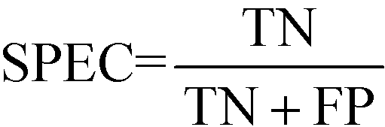
Model performance measures
Confusion Matrix – A 2X2 tabular structure reflecting the performance of the model in four blocks
Accuracy – How accurately / cleanly does the model classify the data points. Lesser the false predictions, more the accuracy
Sensitivity / Recall – How many of the actual True data points are identified as True data points by the model . Remember, False Negatives are those data points which should have been identified as True.
Specificity – How many of the actual Negative data points are identified as negative by the model
Precision – Among the points identified as Positive by the model, how many are really Positive
Confusion Matrix | Predicted Positive | Predicted Negative
Actual Positive | True Positive | False Negative
Actual Negative | False Positive | True Negative
Ref: http://localhost:8888/notebooks/FMTS/classification_metrics-1.ipynb
http://localhost:8888/notebooks/FMTS/ROC_AUC.ipynb

Slide 40
Model performance measures
Assume model is identifying defaulters. In this binary classification defaulter class is class of interest and labeled as +ive (positive - 1) class, other class is –ve(negative - 0)
True Positives - cases where the actual class of the data point and the predicted is same. For e.g. a defaulter (1) predicted as defaulter (1)
True Negatives – cases where the actual class was non-defaulter and the prediction also was non-defaulter
False Positives – cases where actual class was negative (0) but predicted as defaulter (1)
False Negatives – cases where the actual class was positive (1) but predicted as non-defaulter (0)
Ideal scenario will be when all positives are predicted as positives and all negatives are predicted as negatives

Slide 41
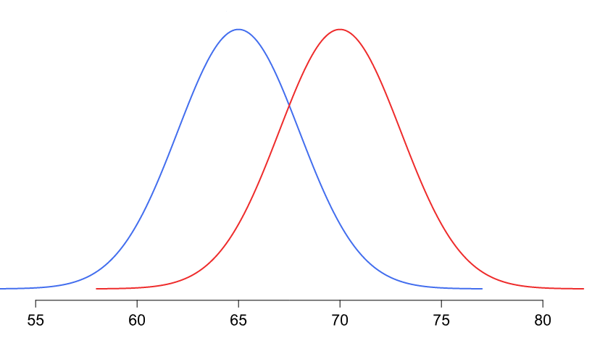
Model performance measures
In practical world this will never be the case. There will be some false positives and false negatives
Our objective will be to minimize both but the problem is, when we minimize one the other will increase and vice versa!
The problem is in the overlap region in the distributions
Objective will be to minimize one of the error types, either the false positive or false negative
Threshold
Non-default
Default
Problem region
Attribute x

Slide 42
Model performance measures
Minimize false negatives - if predicting a positive case as negative is going to be more detrimental for e.g. predicting a cancer patient (positive) as non-cancer (negative)
Minimize false positives – if predicting a negative as positive is going to be more detrimental for e.g. predicting a boss’s mail as spam!
Accuracy – over all correct predictions from all the classes to total number of cases. Should rely on this metrics only when all classes are equally represented. Not reliable if class representation is lopsided as algorithms are biased towards over represented class
Precision - TP/ TP+ FP. When we focus on minimizing false negatives, TP will increase but along with it FP will also increase. How much increase in TP starts hurting (due to increase in FP) ?

Slide 43
Model performance measures
Recall – TP / TP + FN : when we reduce FN to increase TP, how much we gain ? Recall and precision will oppose each other. We want recall to be as close to 1 as possible without precision being too bad
To compare models, we use ROC AUC that gives us the optimal combination of these metrics

Slide 44
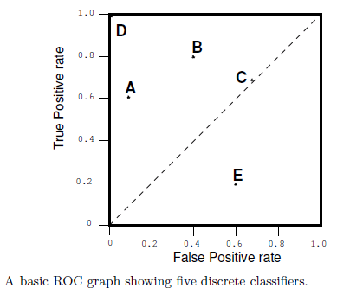
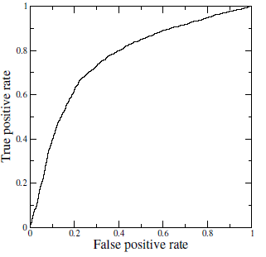
Receiver Operating Characteristics (ROC) Curve
A technique for visualizing classifier performance
It is a graph between TP rate and FP rates
TP rate = TP / total positive
FP rate = FP / total negative
ROC graph is a trade off between benefits (TP) and costs (FP)
The point (0,1) represents perfect classified (e.g. D)
TP = 1 and FP = 0
Classifiers very close to Y axis and lower (nearer to x axis) are conservative models and strict in classifying positives (low TP rate)
Classifiers on top right are liberal in classifying positives hence higher TP rate and FP rate
Ref:ROC_AUC.ipynb , ROC_Threshold_Management.ipynb

Slide 45
Model Parameters Vs Hyperparameters

Slide 46
Model Parameters Vs Hyperparameters
Model parameters refers to the coefficients / weights learnt from the data by the algorithm
Model parameters reflect how the target variable is dependent on the predictor variables. For e.g. in y = mX + c , y is target variable, X is independent variable. How the target variable changes when predictor X changes is captured by m and c
m, c are model parameters learnt from the data by the algorithm and used to create the model
Hyper parameters are used to control the behavior of the algorithm while it is learning the model parameters from the data
Each algorithm has it’s own well defined set of hyper parameters. For e.g. cost or penalty parameters with linear regression model, depth parameter for decision trees
The hyperparameters come with default values which are suitable in most situations
Hyper parameters are integral part of a model.

Slide 47
Model Parameters Vs Hyperparameters
One can modify the hyperparameter values if the situation demands for e.g. change the penalty factor to control the magnitude of the coefficients learnt by the algorithm from the data
When ever we modify the hyperparameters to get desired accuracy scores, it is important to have three data sets… training , validation and testing to prevent data leaks

Slide 48
Linear Regression Hyperparameters

Slide 49
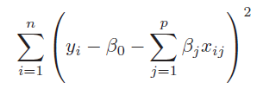
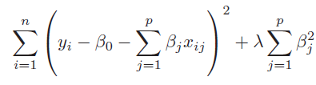
Regularising Linear Models (Shrinkage methods)
When we have too many parameters and exposed to curse of dimensionality, we resort to dimensionality reduction techniques such as transforming to PCA and eliminating the PCA with least magnitude of eigen values. This can be a laborious process before we find the right number principal components. Instead, we can employ the shrinkage methods.
Shrinkage methods attempt to shrink the coefficients of the attributes and lead us towards simpler yet effective models. The two shrinkage methods are :
Ridge regression is similar to the linear regression where the objective is to find the best fit surface. The difference is in the way the best coefficients are found. Unlike linear regression where the optimization function is SSE, here it is slightly different
The term 𝝺 is like a penalty term used to penalize large magnitude coefficients when it is set to a high number, coefficients are suppressed significantly. When it is set to 0, the cost function becomes same as linear regression cost function
Linear Regression cost function
Ridge Regression with additional term in the cost function

Slide 50
Regularising Linear Models (Shrinkage methods)
Why should we be interested in shrinking the coefficients? How does it help?
When we have large number of dimensions and few data points, the models are likely to become complex, overfit and prone to variance errors. When you print out the coefficients of the attributes of such complex model, you will notice that the magnitude of the different coefficients become large
Large coefficients indicate a case where for a unit change in the input variable, the magnitude of change in the target column is very large.
Coeff for simple linear regression model of 10 dimensions
Coeff with polynomial features shooting up to 57 from 10
-9.67853872e-13 -1.06672046e+12 -4.45865268e+00 -2.24519565e+00 -2.96922206e+00 -1.56882955e+00 3.00019063e+00 -1.42031640e+12 -5.46189566e+11 3.62350196e+12 -2.88818173e+12 -1.16772461e+00 -1.43814087e+00 -7.49492645e-03 2.59439087e+00 -1.92409515e+00 -3.41759793e+12 -6.27534905e+12 -2.44065576e+12 -2.32961194e+12 3.97766113e-01 1.94046021e-01 -4.26086426e-01 3.58203125e+00 -2.05296326e+00 -7.51019934e+11 -6.18967069e+11 -5.90805593e+11 2.47863770e-01 -6.68518066e-01 -1.92150879e+00 -7.37030029e-01 -1.01183732e+11 -8.33924574e+10 -7.95983063e+10 -1.70394897e-01 5.25512695e-01 -3.33097839e+00 1.56301740e+12 1.28818991e+12 1.22958044e+12 5.80200195e-01 1.55352783e+00 3.64527008e+11 3.00431724e+11 2.86762821e+11 3.97644043e-01 8.58604718e+10 7.07635073e+10 6.75439422e+10 -7.25449332e+11 1.00689540e+12 9.61084146e+11 2.18532428e+11 -4.81675252e+12 2.63818648e+12
The coefficient for cyl is 2.5059518049385052
The coefficient for disp is 2.5357082860560483
The coefficient for hp is -1.7889335736325294
The coefficient for wt is -5.551819873098725
The coefficient for acc is 0.11485734803440854
The coefficient for yr is 2.931846548211609
The coefficient for car_type is 2.977869737601944
The coefficient for origin_america is -0.5832955290166003
The coefficient for origin_asia is 0.3474931380432235
The coefficient for origin_europe is 0.3774164680868855
Ref: Ridge_Lasso_Regression.ipynb
Very large coefficients!

Slide 51
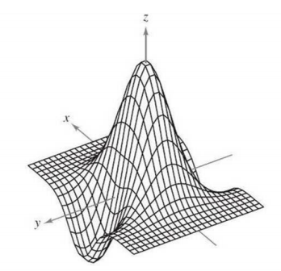
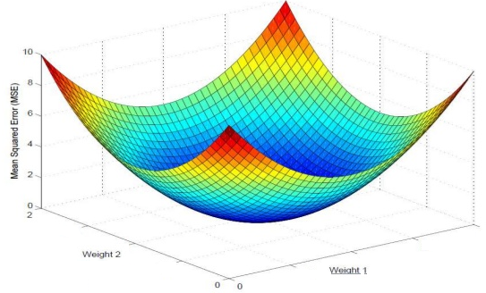
Regularising Linear Models (Shrinkage methods)
Z = f ( x, y)
Curse of dimensionality results in large magnitude coefficients which results in a complex undulated surface / model.
This complex surface has the data points occupying the peaks and the valleys
The model gives near 100% accuracy in training but poor result in testing and the testing scores also vary a lot from one sample to another.
The model is supposed to have absorbed the noise in the data distribution!
Large magnitudes of the coefficient give the least SSE and at times SSE = 0! A model that fits the training set 100%!
Such models do not generalize
= 0

Slide 52
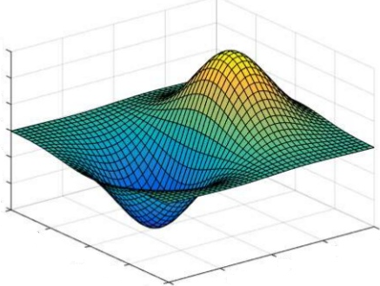
Regularising Linear Models (Shrinkage methods)
In Ridge Regression, the algorithm while trying to find the best combination of coefficients which minimize the SSE on the training data, is constrained by the penalty term
The penalty term is akin to cost of magnitude of the coefficients. Higher the magnitude, more the cost. Thus to minimize the cost, the coefficient are suppressed
Thus the resulting surface tends to be relatively much more smoother than the unconstrained surface. This means we have settled for a model which will make errors in the training data
This is fine as long as the errors can be attributed to the random fluctuations i.e. because the model does not absorb the random fluctuations in the data
Such model will perform equally well on unseen data i.e. test data. The model will generalize better than the complex model
Z = f ( x, y)

Slide 53
Regularising Linear Models (Shrinkage methods)
Impact of Ridge Regression on the coefficients of the 56 attributes
Ridge model: [[ 0. 3.73512981 -2.93500874 -2.13974194 -3.56547812 -1.28898893 3.01290805
2.04739082 0.0786974 0.21972225 -0.3302341 -1.46231096 -1.17221896 0.00856067 2.48054694
-1.67596093 0.99537516 -2.29024279 4.7699338 -2.08598898 0.34009408 0.35024058 -0.41761834
3.06970569 -2.21649433 1.86339518 -2.62934278 0.38596397 0.12088534 -0.53440382 -1.88265835
-0.7675926 -0.90146842 0.52416091 0.59678246 -0.26349448 0.5827378 -3.02842915 -0.36548074
0.5956112 -0.15941014 0.49168856 1.45652375 -0.43819158 -0.20964198 0.77665496 0.36489921
-0.4750838 0.3551047 0.23188557 -1.42941282 2.06831543 -0.34986402 -0.32320394 0.39054656 0.06283411]]
Large coefficients have been suppressed, almost close to 0 in many cases.
Ref: Ridge_Lasso_Regression.ipynb

Slide 54
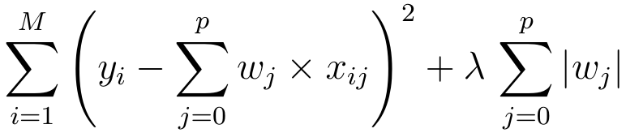
Regularising Linear Models (Shrinkage methods)
Lasso Regression is similar to the Ridge regression with a difference in the penalty term. Unlike Ridge, the penalty term here is raised to power 1. Also known as L1 norm.
The term continues to be the input parameter which will decide how high penalties would be for the coefficients. Larger the value more diminished the coefficients will be.
Unlike Ridge regression, where the coefficients are driven towards zero but may not become zero, Lasso Regression penalty process will make many of the coefficients 0. In other words, literally drop the dimensions

Slide 55
Regularising Linear Models (Shrinkage methods)
Impact of Lasso Regression on the coefficients of the 56 attributes
Lasso model: [ 0. 0.52263805 -0.5402102 -1.99423315 -4.55360385 -0.85285179 2.99044036 0.00711821 -0. 0.76073274 -0. -0. -0.19736449
0. 2.04221833 -1.00014513 0. -0. 4.28412669 -0. 0. 0.31442062 -0. 2.13894094 -1.06760107 0. -0. 0. 0. -0.44991392 -1.55885506 -0. -0.68837902 0.
0.17455864 -0.34653644 0.3313704 -2.84931966 0. -0.34340563 0.00815105 0.47019445 1.25759712 -0.69634581 0. 0.55528147 0.2948979 -0.67289549
0.06490671 0. -1.19639935 1.06711702 0. -0.88034391 0. -0. ]
Large coefficients have been suppressed, to 0 in many cases, making those dimensions useless i.e. dropped from the model.
Ref: Ridge_Lasso_Regression.ipynb

Slide 56
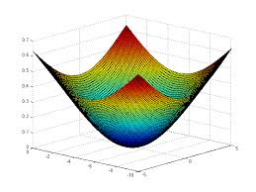
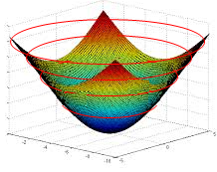

Regularising Linear Models (Comparing The Methods)
To compare the Ridge and Lasso, let us first transform our error function (which is a quadratic / convex function) into a contour graph
Every ring on the error function represents a combination of coefficients (m1 and m2 in the image) which result in same quantum of error i.e. SSE
Let us convert that to a 2d contour plot. In the contour plot, every ring represents one quantum of error.
The innermost ring / bull’s eye is the combination of the coefficients that gives the lease SSE
m2
m1

Slide 57
Regularising Linear Models (Ridge Constraint)
Most optimal combination of m1, m2 given the constraints
Yellow circle is the Ridge constraint region representing the ridge penalty (sum of squared coeff)
Any combination of m1 nd m2 that fall within yellow is a possible solution
The most optimal of all solutions is the one which satisfies the constraint and also minimizes the SSE (smallest possible red circle)
Thus the optimal solution of m1 and m2 is the one where the yellow circle touches a red circle.
Lowest SSE error ring. violates the constraint
m2
Sub-optimal combination of m1, m2. Meets constraint but is not the minimal possible SSE within constraint
Allowed combination of m1, m2 by Ridge Constraints
m1
The point to note is that the red rings and yellow circle will never be tangential (touch) on the axes representing the coefficient. Hence Ridge can make coefficients close to zero but never zero. You may notice some coefficients becoming zero but that will be due to roundoff…

Slide 58
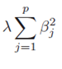
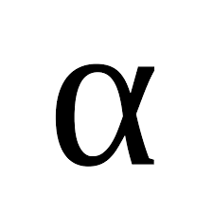
Regularising Linear Models (Ridge Constraint)
As the lambda value (shown here as alpha) increases, the coefficients have to become smaller and smaller to minimize the penalty term in the cost function i.e. the
The larger the lambda, smaller the sum of squared coefficients should be and as a result the tighter the constraint region
The tighter the constraint region, the larger will be the red circle in the contour diagram that will be tangent to the boundary of the yellow region
Thus, higher the lambda, stronger the shrinkage, the coefficients are shrinked strongly and hence more smooth the surface / model
More smoother the surface, more likely the model is going to perform equally well in production
When we move away from a model with sharp peaks and valleys (complex model) to smoother surface (simpler models), we reduce the variance errors but bias errors go up.
Using gridsearch, we have to find the right value of lambda which results in right fit, neither too complex nor too simple a model
m2
m1

Slide 59
Regularising Linear Models (Lasso Constraint)
Most optimal combination of m1, m2 given the constraints
Yellow rectangle is the Lasso constraint region representing the Lasso penalty (sum coeff)
Any combination of m1 nd m2 that fall within yellow is a possible solution
The most optimal of all solutions is the one which satisfies the constraint and also minimizes the SSE (smallest possible red circle)
Thus the optimal solution of m1 and m2 is the one where the yellow rectangle touches a red circle.
Lowest SSE error ring. violates the constraint
m2
Sub-optimal combination of m1, m2. Meets constraint but is not the minimal possible SSE within constraint
Allowed combination of m1, m2 by Lasso Constraints
m1
The beauty of Lasso is, the red circle may touch the constraint region on the attribute axis! In the picture above the circle is touching the yellow rectangle on the m1 axis. But at that point m2 coefficient is 0! Which means, that dimension has been dropped from analysis. Thus Lasso does dimensionality reduction which Ridge does not

Slide 60
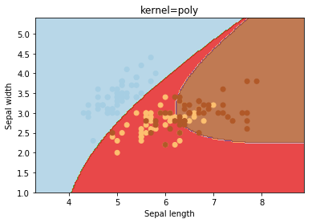
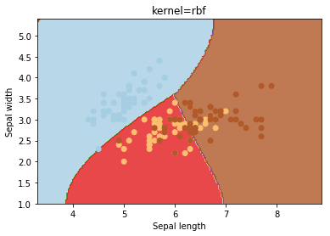
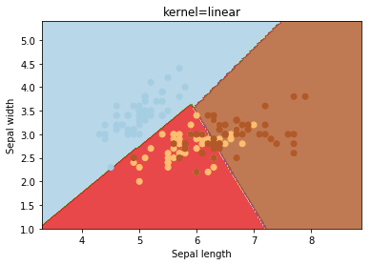
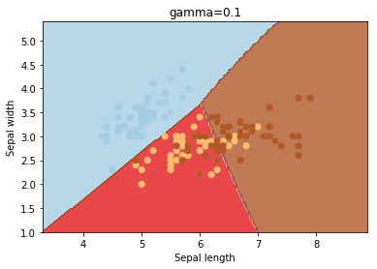
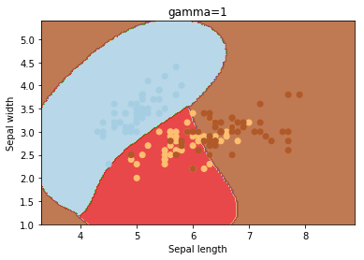
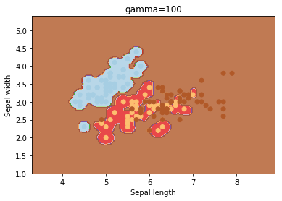
SVC Hyperparameters - Kernels
Hyperparamter_SVC.ipynb
SVC Hyperparameters - gamma

Slide 61
SVC Hyperparameters – C
Hyperparamter_SVC.ipynb
SVC Hyperparameters - gamma

Slide 62
Hyper Parameters & Tuning
Hyper parameters are like handles available to the modeler to control the behavior of the algorithm used for modeling
Hyper parameters are supplied as arguments to the model algorithms while initializing them. For e.g. setting the criterion for decision tree building “dt_model = DecisionTreeClassifier(criterion = 'entropy’ )”
To get a list of hyper parameters for a given algorithm, call the function get_params()…for e.g. to get support vector classifier hyper parameters
from sklearn.svm import SVC
svcl= SVC()
svc.get_params()
Hyper parameters are not learnt from the data as other model parameters are. For e.g. attribute coefficients in a linear model are learnt from data while cost of error is input as hyper parameter.
Ref: Models_HyperParameters.ipynb

Slide 63
Hyper Parameters & Tuning
Fine tuning the hyper parameters is done in a sequence of steps
Selecting the appropriate model type (regressor or classifier such as sklearn.svm.SVC())
Identify the corresponding parameter space (Ref: model_parameters.csv)
Decide the method for searching or sampling parameter space;
Decide the cross-validation scheme to ensure model will generalize
Decide a score function to use to evaluate the model
Two generic approaches to searching hyper parameter space include
GridSearchCV which exhaustively considers all parameter combinations
RandomizedSearchCV can sample a given number of candidates from a parameter space with a specified distribution.
While tuning hyper parameters, the data should have been split into three parts – Training, validation and testing to prevent data leak
The testing data should be separately transformed * using the same functions that were used to transform the rest of the data for model building and hyper parameter tuning
Ref: GridSearchSimpleExample.ipynb
* Any transformation where rows influence each other. For e.g. using zscore. OneHotCode transformation does not come into this category. It can be done before splitting the data

Slide 64
Hyper Parameters & Tuning (GridsearchCV/ RandomizedSearchCv)
GridsearchCV –
Is at basic optimal hyperparameter tuning technique.
It builds a model for each permutation of all of the given hyperparameter values
Each such model is evaluated and ranked.
The combination of hyperparameter values that gives the best performing model is chosen
For every combination, cross validation is used and average score is calculated
This is an exhaustive sampling of the hyperparameter space and can be quite inefficient

Slide 65

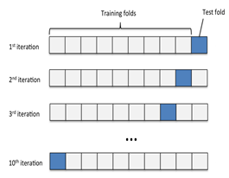
GridSearchCV
One combination of hyper parameters used K times to train and test. The avg score of the K times is the score associated with this combination
This will repeat for all possible combinations i.e. all the cells in the space.
hp3
hp2
hp1
Hyper parameter space
Ref: GridSearchCV_compare_models.ipynb,

Slide 66
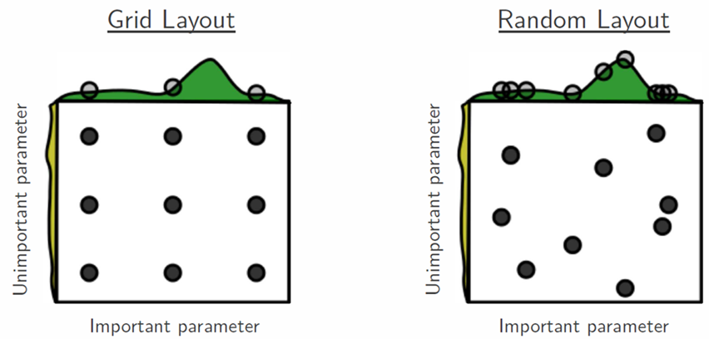
Hyper Parameters & Tuning (GridsearchCV/ RandomizedSearchCv)
RandomizedSearchCV –
Random search differs from grid search. Instead of providing a discrete set of values to explore on each hyperparameter (parameter grid), we provide a statistical distribution.
Values for the different hyper parameters are picked up at random from this combine distribution
The motivation to use random search in place of grid search is that for many cases, hyperparameters are not equally important.
A Gaussian process analysis of the function from hyper-parameters to validation set performance reveals that for most data sets only a few of the hyper-parameters really matter, but that different hyper-parameters are important on different data sets. This phenomenon makes grid search a poor choice for configuring
algorithms for new data sets. - Bergstra, 2012
Picture by Bergstra, 2012

Slide 67
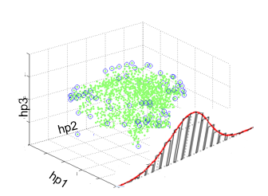
RandomizedSearchCV
Randomly pick up n-iter samples from the hyper parameter distribution as sample, Use it K times and find avg performance
Hyper parameter space
Ref: RandomizedSearchCV_GridSearchCV.ipynb
In contrast to GridSearchCV, not all combinations are evaluated. A fixed number of parameter settings is sampled from the specified distributions.
The number of parameter settings that are tried is given by n_iter
If all parameters are presented as a list, sampling without replacement is performed. If at least one parameter is given as a distribution, sampling with replacement is used. It is highly recommended to use continuous distributions for continuous parameters
Randomsearch has higher chance of hitting the right combination than gridsearch. Ref: Decision_Tree_Regressor_Concrete_Regularization_GridSearchCV.ipynb

Slide 68
Pipelines

Slide 69
What is a pipeline-
Almost always, we need to tie together many different processes that we use to prepare data for machine learning based model
It is paramount that the stage of transformation of data represented by these processes are standardized
Pipeline class of sklearn helps simplify the chaining of the transformation steps and the model
Pipeline, along with the GridsearchCV helps search over the hyperparameter space applicable at each stage

Slide 70
Pipelines
Sequentially apply a list of transforms and a final estimator.
Intermediate steps of the pipeline must be ‘transforms’, that is, they must implement fit and transform methods.
The final estimator only needs to implement fit
Helps standardize the model project by enforcing consistency in building testing and production. Ref: https://scikit-learn.org/stable/modules/compose.html
Building Model
Load Data
Split data
Scale data
Call functions
fit()
Predicting
Load Data
Split data
Scale data
Call functions
predict()
Ref:Pipeline_Simple.ipynb, Pipeline_Gridsearch.ipynb

Slide 71
Build a pipeline
Import the pipeline class
from sklearn.pipeline import Pipeline
Instantiate the class into an object by listing out the transformation steps. In the following example, a scaling function is followed by the SVC algorithm
pipe = Pipeline([(" scaler", MinMaxScaler()), (" lr", logisticregression())])
Call the fit() function on the pipeline object
pipe.fit( X_train, y_train)
Call the score() function on the pipeline object or predict() function
pipe.score( X_test, y_test)
In the step 2b, the pipeline object is created using a dictionary of key:value pairs. The key is specified in strings for e.g. “scaler” followed by the function to be called.
The key is the name given to a step.
Pipeline_simple.ipynb
Build a pipeline for wisc_bc_data using SVC

Slide 72
Build a pipeline (Contd…)
The pipeline object requires all the stages included to have a “transform()” function except for the last stage which is an estimator.
The transform step transforms the input data. The transformed output of a stage is the input to the next stage
During the call “pipeline.fit()”, the pipeline calls the fit and transform functions on each step in sequence. For the last step, only the fit function is called
While predicting using pipeline, similarly transform function in all the stages followed by a predict function in the last stage is performed
The pipeline object does not need to have a predict function. It only needs to have a fit function at least

Slide 73
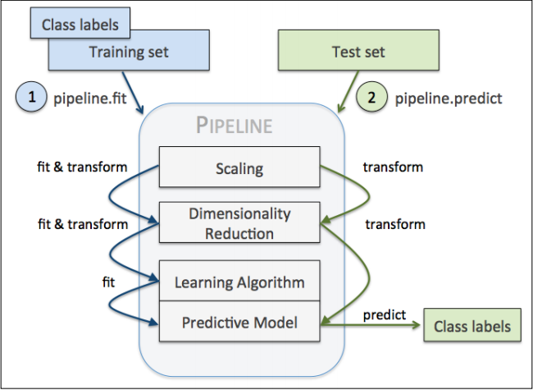
Build a pipeline (Contd…)
Image Source : Python Deeper Insights Into Machine Learning

Slide 74
make_pipeline
Creating the pipeline could be cumbersome. Specifying a name to each stage may not be necessary
Alternatively there is a “make_pipeline()” function that will create the pipeline and automatically name each step. We do not need to specify a name
from sklearn.pipeline import make_pipeline
pipe = make_pipeline( MinMaxScaler(), (SVC()))
print(" Pipeline steps:\ n{}". format( pipe.steps))
Note, we have not specified any name to the stages. The names will be automatically assigned and are usually lowercase of the class names
pipeline_introduction.ipynb

Slide 75
make_pipeline
Download Wisconsin Breast Cancer dataset from UCI
Create dataframe
Split into X and y
Transform y into numerical using labelencoder
Split data into training testing
Standardize dataset using standard scalar
Use PCA to reduce to 2 dimensions
Use logistic regression on the reduced dimensions
Create a pipeline
Do a fit and score
Pipeline_GridSearchcv_wisc_bc_data_classwork.ipynb

Slide 76
Sampling

Slide 77
It all begins with sampling…. So do bias and variance errors
For a sample to be close representative of the population we need the right attributes, right size, correct class representation
A sample being subset of the population can fall short of these requirements. As a result, it represents subset of the patterns, also have unexplained patterns that get clubbed as residuals
Problem becomes acute when we are in classification and the data is imbalanced in terms of representing the classes.

Slide 78
Sample Data (Analytics Base Table)
Three Random Training Sets From ABT
Three Random Test Sets From ABT

Slide 79
Imbalanced datasets impact outcome of ML models negatively when the class of importance is under represented
The ML algorithms such as decision trees, logistic regressions are designed to reduce overall inaccuracies and hence get biased towards over represented class
When class of importance is under represented, no amount of tuning the models will help
Suppose we have 1000 records of which 20 are fraudulent cases and 980 normal cases. We have to predict fraudulent cases accurately. The event rate is only 2%. Conventional classifiers tend to perform higher Type II errors (fraudulent cases identified as normal)

Slide 80

We can handle the imbalanced dataset cases to minimize the Type II errors by balancing the class representations
To balance the classes we can –
Decrease the frequency of the majority class
Increase the frequency of the minority class OR

Slide 81
Decreasing the frequency of majority class is done using random under sampling. For e.g.
Total observations – 1000
Fraud - 020
Non-fraud - 980
Event rate of interest - 2%
Take 10% of non-fraud cases randomly - 98
Club with the fraud cases – 118 sample size
Modified event rate - 20 / 118 = 17%
Ref: Logistic_up_down_sample_Pima.ipynb

Slide 82
Random oversampling is used to increase the frequency of minority class. This is done by replicating them in order to increase their representation. For e.g.
Total observations – 1000
Fraud - 020
Non-fraud - 980
Event rate of interest - 2%
Replicate a % of fraud cases n times e.g. 10 cases 20 times
Sample size changes from 1000 to 1200
Modified event rate - 220/1200 = 18%
The simplest implementation of over-sampling is to duplicate random records from the minority class, which can cause overfitting.
In under-sampling, the simplest technique involves removing random records from the majority class, which can cause loss of information.
Ref: Logistic_up_down_sample_Pima.ipynb

Slide 83
Imblearn Techniques
Python imbalanced-learn module – provides more sophisticated resampling techniques
For example, we can cluster the records of the majority class, and do the under-sampling by removing records from each cluster, thus seeking to preserve information.
In over-sampling, instead of creating exact copies of the minority class records, we can introduce small variations into those copies, creating more diverse synthetic samples.
Ref: Logistic_up_down_sample_Pima.ipynb

Slide 84
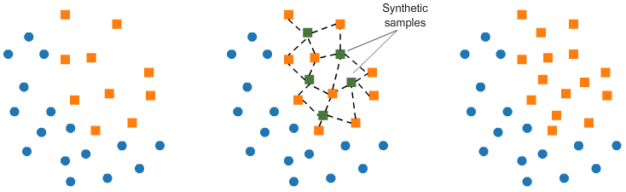
Imblearn Techniques
SMOTE (Synthetic Minority Oversampling TEchnique)
consists of synthesizing elements for the minority class, based on those that already exist.
It works randomly picking a point from the minority class and computing the k-nearest neighbors for this point.
Synthetic points are added between the chosen point and its neighbors.
Ref: Logistic_up_down_sample_Pima.ipynb

Slide 85

Imblearn Techniques
Tomek links T-Link
Tomek links are pairs of very close instances, but of opposite classes.
Removing the instances of the majority class of each pair increases the space between the two classes, facilitating the classification process.

Slide 86
Imblearn Techniques
Cluster centroid based under sampling -
Method that under samples the majority class by replacing a cluster of majority samples by the cluster centroid of a KMeans algorithm.
This algorithm keeps N majority samples by fitting the KMeans algorithm with N cluster to the majority class and using the coordinates of the N cluster centroids as the new majority samples.

Slide 87
The imbalanced-learn documentation: http://contrib.scikit-learn.org/imbalanced-learn/stable/index.html
The imbalanced-learn GitHub: https://github.com/scikit-learn-contrib/imbalanced-learn
Comparison of the combination of over- and under-sampling algorithms: http://contrib.scikit-learn.org/imbalanced-learn/stable/auto_examples/combine/plot_comparison_combine.html
Chawla, Nitesh V., et al. "SMOTE: synthetic minority over-sampling technique." Journal of artificial intelligence research 16 (2002): https://www.jair.org/media/953/live-953-2037-jair.pdf

Slide 88
Deploying Models

Slide 89
Serializing / Deserializing Python objects -
All models are objects. For e.g.
model = LogisticRegression(solver='lbfgs')
model.fit(train_set, train_labels)
In the example above a logistic Regressor class has been configured and instantiated as an object called “model”. Subsequently the method “fit()” is called.
“Pickle” is a utility available in python to serialize and deserialize a python object.
Serializing is a way of storing an object in byte streams. Deserialize is the process of reading and converting byte stream back to object
Pickle can transform a complex object into a byte stream and it can transform the byte stream into an object with the same internal structure
Ref: https://docs.python.org/2/library/pickle.html

Slide 90
Serializing / Deserializing Python objects -
The byte streams can be stored into a file and also sent across a network or store them in a database
Pickling an object will transform the object into a stream of bytes. For e.g.
import pickle
obj1 = [1, 'LinearModel']
pickled_obj = pickle.dumps(obj1)
pickled_obj
The serialized form of the object can be loaded back into memory and transformed into an object. In this example, into a list
obj2 = pickle.loads(pickled_obj)
obj2
b'\x80\x03]q\x00(K\x01X\x0b\x00\x00\x00LinearModelq\x01e.'
[1, 'LinearModel']

Slide 91
Pickling scikit models to import or export for use in other Python scripts
import pickle
#creating and training a model
regr = linear_model.LinearRegression()
regr.fit(features, label)
#serializing our model to a file called model.pkl
pickle.dump(regr, open("model.pkl","wb"))
#loading a model from a file called model.pkl
model = pickle.load(open("model.pkl","r"))

Slide 92
Deploying Scikit models on the web -
Models can be deployed as executable code. For e.g. create a function in java or C that takes as input the attribute values of production data, multiply with respective coefficients and adds the intercept (parameters of the model) and emits the output
Python models can be converted to objects and used in python scripts
Models can also be deployed as web applications that take as input a test record and emit the predictions as output
For this approach we need a webserver that will fire the webapp on a request.
Server will listen to web traffic at an IP and a port, and execute functions such as model.predict() when they find a request addressed to them.
The server then sends the result back to the requestor

Slide 93
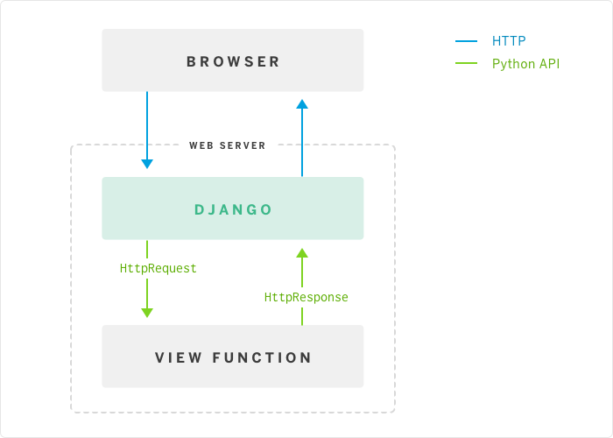
Pickling and deploying a simple model using Flask-
Flask / Django is a Python framework that helps create web servers easily. Can be used for working POC development
The web server call the model object predict() function for the given input, capture the results and render it using a template
Model

Slide 94
Model testing in production -
Models are often tested using Kfold approach where the hyper parameters are evaluated using the gridsearch or randomsearch
Once the models perform well relative to some pre-defined benchmark such as the 95% confidence performance in production ranges from 80% - 90%, they are deployed into production
However, in production too they have to be tested, akin to alpha testing beta testing but the evaluation may happen over time, not immediately as in testing
If a production model already exists, perform A/B testing –
The new model is run in parallel with existing model.
Input data is routed to both the models
The prediction accuracy distributions are compared using hypothesis testing
If this is a new first time model –
Redesign the production processes (maybe temporarily) to feed data to the model
Capture distribution of metrics of interest (metrics used in testing)
Is the 95% confidence level found before deployment being met?

Slide 95
Model testing in production -
To evaluate the model in the production testing, we need to have predefined metrics in place and these metrics may not always be measurable immediately. For e.g. how can the mpg prediction model be evaluated in production?
To predict modeling accuracy, one needs to collect lot of cases /data. Cannot judge based on one single data point.
The models should be evaluated not only on the model metrics but also using business metrics. Did the new model impact topline significantly (statistical testing)
Whether the model is finally going to be deployed in streamline or batch mode, assessing the usefulness of the model will take time
All models drift over time. Their predictive power degrades with time. This may be due to changes in the production environment such as changing importance of the attributes, appearance of new attributes that were not part of the data while the model was built
All models need re-calibration regularly where the frequency is problem specific. Models also have to be scraped / replaced over time

Slide 96
ThankYou

Slide 97
Project

Slide 98
Project Flow
Seq no | Milestone | Purpose | Key Tasks
1 | Define the project | To be clear on the objective of the project | Name the project, Define the purpose and source of data
2 | Data loading and check | Understand data. Column names and meanings, potential problems, meaning | What do the columns represent How data was collected and when Expected problems
3 | Exploratory data analysis | Understand the data in terms of central values, spread, extreme values, missing values, sampling errors, interactions, mix of gaussians | Univariate analysis using descriptive statistics , Bi-variate analysis Pair plot analysis
4 | Data Preparation | Missing value treatment, Outlier value treatment, analysis of the gaussians (if they exist), Segregating data for training, validation and testing | Decide the appropriate strategy to i and handle both missing values and outliers
5 | Establish reliability of the data | Does it represent the current process? Has the strategy for missing data and outlier handling adversely impacted the data set’s representation , after the split, do the training, validation and test represent the process | Statistical tests such as T-Test, Normal Deviate Z Test, Analysis of variance
6 | Feature engineering and selection | Identify the columns from the given dataset that have the potential for being good features, explore the possibility of creating new powerful features , scale the data | Bi-variate / multi-variate analysis, exploring the pair plot, scaling method
7 | Select ML algorithms | Identify suitable algorithm/s, create base model Identify the hyper parameters to evaluate and set | Given the purpose, given the data distributions, from pair plot, identify suitable algorithms
Exploratory data analysis
Feature engineering and selection
Compare several machine learning models on a performance metric
Perform hyperparameter tuning on the best model
Evaluate the best model on the testing set
Interpret the model results
Draw conclusions and document work

Slide 99
Project Flow
Seq no | Milestone | Purpose | Key Tasks
8 | Explore the model architecture | If using deep neural networks, select the right input and output layer size, number of hidden layers, | Input / ouput layer size Hidden layers and size Activation functions, loss functions, optimizer function and variants
9 | Build and compile the model | Build the models | Build the model in Python with minimal coding (use functions)
10 | Hyper parameter tuning | For the selected algorithms, evaluate the hyper parameters | Use random grid search to identify optimal values of the hyper parameters
11 | Evaluate the models | Assess the reliability of the model and estimate the range of accuracy at 95% confidence for each model | Kfold Cross Validation / Bootstrap sampling on test data, Use confusion matrix, classification metrics to ensure model will generalize, PowerTest
12 | Ensemble the model | Select the top few models based on their 95% confidence performance and ensemble | Select appropriate ensemble techniques – Bagging ,Boosting, RandomForest
13 | Create the pipeline | Standardize the steps for data transformation that were employed to create the model | Make pipeline, check the pipeline on test set
14 | Deploy the model | Deploy the model in production environment. | Integrate with existing processes/ re-design the process flows/
15 | Project Report | Document the steps and methodologies | Document the steps taken for every milestone (The documentation should be done in the code to explain the steps and also separately in detail at project level

Slide 100
Project Description
Project Name – Green Building Rating
Objective – Build a model to assess energy rating of a building from the given parameters
Purpose - Replace manual evaluation method with a reliable automated way of evaluation
Data Source –publicly available building energy data about New York city at https://www1.nyc.gov/html/gbee/html/plan/ll84_scores.shtml

Slide 101
About The Data
Local Law 84 of 2009, or the NYC Benchmarking Law, requires annual benchmarking and disclosure of energy and water usage information. Covered properties include tax lots with a single building with a gross floor area greater than 50,000 square feet (sq ft) and tax lots having more than one building with a gross floor area of more than 100,000 sq ft. Starting in 2018, the NYC Benchmarking Law will also include properties greater than 25,000 sq ft. Metrics are calculated by the Environmental Protection Agency’s tool ENERGY STAR Portfolio Manager, and data is self-reporting by building owners. The public availability of data allows for local and national comparison of a buildings’ performance, incentivizes the most accurate benchmarking of energy usage, and informs energy management decisions.
Source: https://www1.nyc.gov/html/gbee/downloads/misc/nyc_benchmarking_disclosure_data_definitions_2017.pdf
Understand what the data is about, what the columns mean… ignoring this, may result in missing important information that would have made a model powerful.

Slide 102
Understand the data
Understand what the data is about, what the columns mean… ignoring this, may result in missing important information that would have made a model powerful.
NYC law requires properties of certain size and above to report their energy usage
Energy Star Score is a 1 – 100 percentile ranking based on the energy consumption annually
Energy Star Score is a relative measure for comparing energy efficiency of the buildings
https://www1.nyc.gov/html/gbee/downloads/misc/nyc_benchmarking_disclosure_data_definitions_2017.pdf

Slide 103
Load Data
Local Law 84 of 2009, or the NYC Benchmarking Law, requires annual benchmarking and disclosure of energy and water usage information. Covered properties include tax lots with a single building with a gross floor area greater than 50,000 square feet (sq ft) and tax lots having more than one building with a gross floor area of more than 100,000 sq ft. Starting in 2018, the NYC Benchmarking Law will also include properties greater than 25,000 sq ft. Metrics are calculated by the Environmental Protection Agency’s tool ENERGY STAR Portfolio Manager, and data is self-reporting by building owners. The public availability of data allows for local and national comparison of a buildings’ performance, incentivizes the most accurate benchmarking of energy usage, and informs energy management decisions.
Source: https://www1.nyc.gov/html/gbee/downloads/misc/nyc_benchmarking_disclosure_data_definitions_2017.pdf

